Slide 1

A powerful tool for TDD

Slide 2
What is Mockito?
A Mock Framework which is TDD friendly
No DSL, only Java
Based on Method calls, not Strings
Painless refactoring
Notes:
TDD Friendly
No DSL, only Java
Based on Method calls, not Strings
Painless refactoring
ex: renaming methods, classes

Slide 3
EasyMock to Mockito
Szczepan Faber(Author of Mockito) :
I was brought up on EasyMock. Normal kids got milk, I got classes to test.
Founded at 2008 Jan

Slide 4
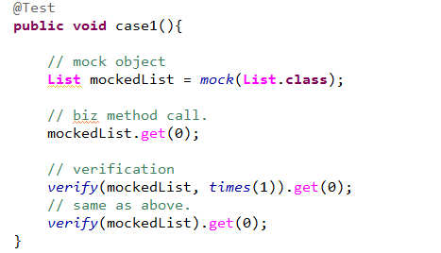
Basics of Mockito
A usage of Mockito follows three steps:
Define a mock Object
Call Business method
verification

Slide 5
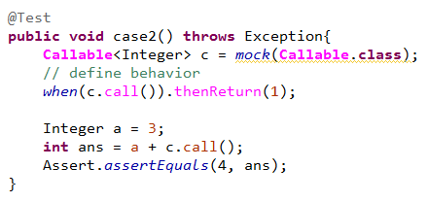
Customize Mock Behaviors
To define a more specific Mock object with further reactions while business invocation.

Slide 6
Verifications
Let’s take a look at the code!

Slide 7
Stubbings
Let’s take a look at the code!

Slide 8
Spy
What for real object? Spy.
Let’s take a look at the code!

Slide 9
Spy(2)
We need Spy here.

Slide 10
Extensions - Jukito
Combined Juice with Mockito

